Slide 1

Admin Login
User ID
Password
Login

Slide 2

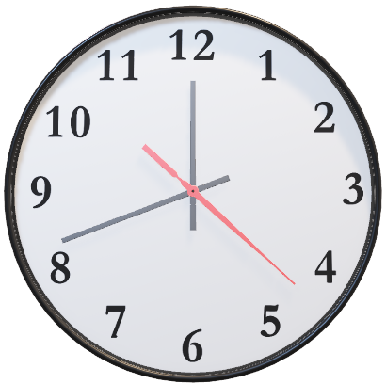
Employee Attendance System
Where minutes managed and success engineered.
11/21/23 || 5:20 PM
Employee Maintenance
Log-in Report
Daily Attendance Report
Monthly Attendance Report

Slide 3

Daily Attendance Report
Date: 11/21/2023
Employee Name | AM In | AM Out | PM In | PM Out

Slide 4
Monthly Attendance Report
Month of November 2023
Employee Name: Ed Sheeran
Date | AM In | AM Out | PM In | PM Out

Slide 5

Employee Attendance System
Name
AM
IN
OUT
Employee ID
Search
PM
IN
OUT

Slide 6
Employee Attendance System
Employee ID
Search
Name
AM IN
AM OUT
PM IN
PM OUT

